Slide 1
Xavier University School Of Medicine, Aruba
SARS-CoV-2 infection and its association with hyperglycemia and inflammatory biomarkers in COVID-19 subjects: A Clinical Study
Ravindra P Veeranna, DVM, PhD, FLMF
Dean and Professor
Xavier University School of Veterinary Medicine, Aruba, HQ: New York, USA.

Slide 2
Xavier University School Of Medicine, Aruba
Notes:
Jill

Slide 3
The mission of Xavier University Aruba is to prepare physicians and veterinarians to practice compassionate medicine and veterinary medicine of the highest standard.
Notes:
Jill

Slide 4
Notes:
Jill

Slide 5
XAVIER’S RESIDENTIAL CAMPUS IN ARUBA
24/7 security
Cafeteria
Transportation
Recreation options
Environmentally friendly
Notes:
Jill

Slide 6
Xavier University School Of Medicine, Aruba
Notes:
Jill

Slide 7
Xavier University School Of Medicine, Aruba
ARUBA-ONE HAPPY ISLAND
Aruba is one the SAFEST islands in the Caribbean.
Easy flights between USA and Aruba.
Located just below the hurricane belt, Aruba doesn't experience extreme weather like most other Caribbean islands.
Aruba has a very well-developed infrastructure for roads, electricity, and Wi-Fi.
Notes:
Jill

Slide 8
Xavier University School Of Medicine, Aruba
GLOBAL PHYSICIAN SHORTAGE
The World Health Organization (WHO) estimates that there is a global shortage of 4.3 million physicians, nurses, and other health professionals.
GLOBAL VET SHORTAGE
It is estimated that there will be a shortage of more than 150,000 worldwide by 2030.
What does this mean for you?
There will be a significant number of jobs available for you to enter either field.
Gainful employment with good paying jobs!
Notes:
Jill

Slide 9
MD PROGRAM
1½ years in
Aruba
MD Program
2 years in
USA
2 Years in Aruba
Residency in USA
or Canada
Pre-Health
Clinical Rotations
VETERINARY PROGRAM
1½ years in
Aruba
Vet Program
1 year
(multiple locations)
3 years in Aruba
Licensing Exam &
Practice Worldwide
Pre-Health
Clinical Rotations
Tuition: DVM: $57000/4yrs, MD: 140,000/4 yrs.

Slide 10
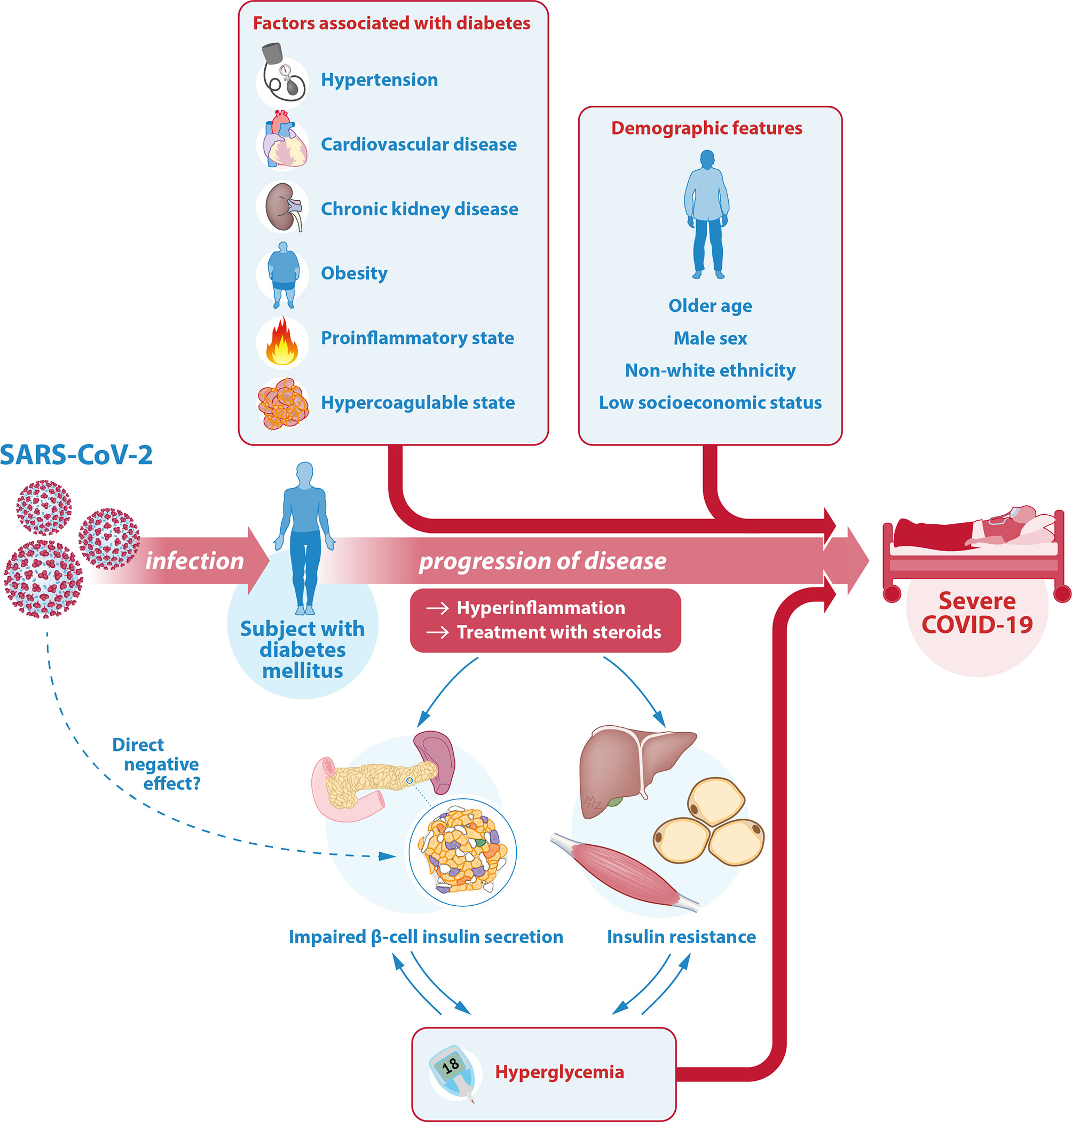
Xavier University School Of Medicine, Aruba
Background
Diabetes and COVID-19
Diabetes mellitus (DM) is a common comorbidity in COVID-19 patients
Hyperglycemia at hospital admission-major risk factor-poor prognosis
Hematological and inflammatory parameters-severity in COVID-19
doi.org/10.3389/fendo.2021.649525

Slide 11
Xavier University School Of Medicine, Aruba
Objective of the study
To assess the impact of hyperglycemia at hospital admission on hematological and inflammatory parameters in COVID-19 patients

Slide 12
Xavier University School Of Medicine, Aruba
Methodology
Observational cross-sectional cohort study
A total of 550 COVID-19 subjects
Institutional ethics committee (MMCEC36/2021).
COVID-19 RT-PCR positive RBS
Normoglycemic (RBS <140 mg/dL)
Hyperglycemic (RBS >140 mg/dL)
Oxygen saturation,
Serum ferritin,
Lactate dehydrogenase (LDH),
Total leukocyte count (TLC),
Neutrophil count,
Lymphocyte count.

Slide 13
Xavier University School Of Medicine, Aruba
Results
Majority of patients were unvaccinated
Among the 550 subjects
354 (64.36%)-males with avg. age 30-60 yrs.
442 (80.36%)-not received vaccination
>68%-fever and cough
45%-breathlessness

Slide 14
Patients were age, gender, and matched for vaccination status
Normoglycemic group (n=202)
127 (62.87%)-Males
136 (67.32%)-Age group 30-60 yrs.
159 (78.71%)-Unvaccinated
> 64%-Fever and cough
41%-Breathlessness
32/202 (15.84%)-Preexisting diabetes
Hyperglycemic group (n=348)
227 (65.22%)-Males.
232(66.66%)-Age group 30-60 yrs.
283 (81.32%)-Unvaccinated
> 70%-Fever and cough
47%-Breathlessness.
225 (64.65%)-New-onset hyperglycemia,
126 (36.20%)-Preexisting diabetes

Slide 15
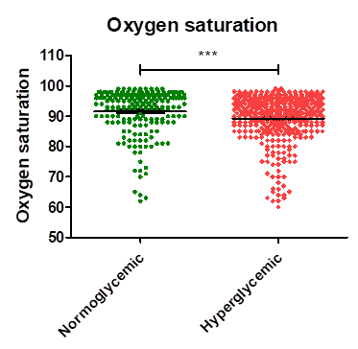
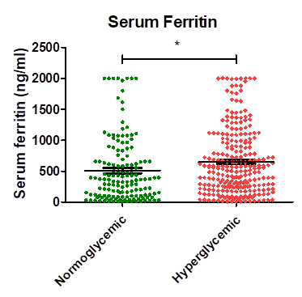
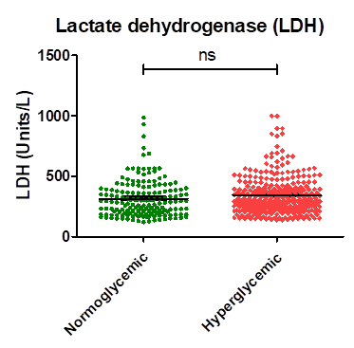
Xavier University School Of Medicine, Aruba
HG Patients showed significant increases in O2 sat. Serum ferritin levels
1a
1b
1c
NG: 91.55%
HG: 89.24%
NG: 509.5 ng/ml
HG: 650.0 ng/ml
NG: 315.9 units/L
HG: 344.3 units/L

Slide 16
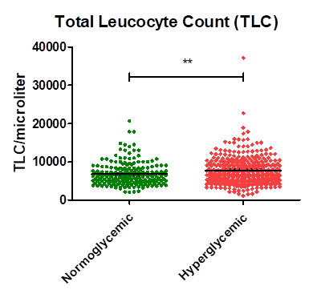
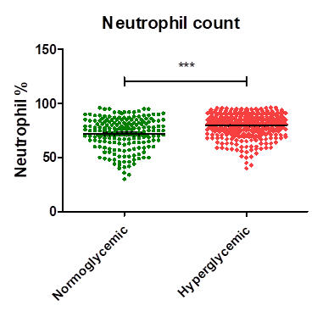
Xavier University School Of Medicine, Aruba
HG Patients had significant increases in TLC and NC
2a
2b
NG: 6814/microliter
HG: 7699/microliter
NG: 72.16%
HG: 80.10%
HG Patients: Bacterial infections

Slide 17
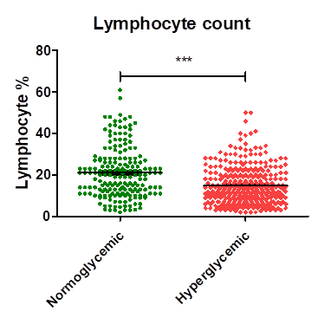
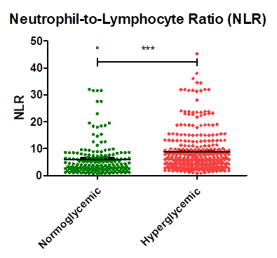
HG Patients had significant decreases in lymphocyte and increases in NLR ratio
2c
2d
NG: 21.05%
HG: 14.77%
NG: 6.034
HG: 8.769
HG Patients: Immunosuppression and bacterial infections

Slide 18
Conclusion and Future studies
COVID-19 infection
Direct??
Hyperglycemia
Immunosuppression
Inflammation
Indirect??
Poor Prognosis
Transient or chronic hyperglycemia Diabetes????

Slide 19
Thank You All
Website: XUSOM.com, XUSOVM.com
Email: rveerannaphd@xusom.com
Notes:
Mike

